Slide 1
Heart Failure
Dr Kola Akinlabi

Slide 2
Heart Failure – Definition & Overview
Inability of the heart to pump sufficient blood to meet metabolic demands
Reduced cardiac output and/or increased filling pressures
Leads to pulmonary and/or systemic congestion
Acute (sudden onset) or chronic (progressive condition)
Common causes: IHD, hypertension, valvular disease, cardiomyopathy

Slide 3
Pathophysiology
↓ Cardiac Output → SNS + RAAS Activation
👉 When the heart cannot pump effectively:
↓ Blood flow to vital organs (brain, kidneys)
The body compensates:
🔸 Sympathetic Nervous System (SNS)
↑ Heart rate (tachycardia)
↑ Contractility
Vasoconstriction
👉 Short term: helps maintain BP
👉 Long term: increases cardiac workload → worsens HF
RAAS (Renin-Angiotensin-Aldosterone System)
Triggered by ↓ renal perfusion:
Renin → Angiotensin II → Aldosterone
👉 Effects:
Vasoconstriction → ↑ afterload
Sodium + water retention → ↑ blood volume
👉 Result:
More strain on already failing heart

Slide 4
Pathophysiology cont’d
2. Fluid Retention → Pulmonary Oedema
👉 Because of RAAS activation:
↑ circulating volume
↑ pressure in pulmonary circulation
Leads to:
Fluid leaking into alveoli
🔬 What happens in lungs:
Alveoli fill with fluid instead of air
Gas exchange becomes impaired
🫁 Clinical signs:
Crackles
Dyspnoea
Orthopnoea
Pink frothy sputum (severe)
🔹 3. V/Q Mismatch → Dyspnoea
👉 Normal:
Ventilation (V) matches Perfusion (Q)
👉 In HF:
Alveoli filled with fluid → poor ventilation
Blood still flowing → good perfusion

Slide 5
Clinical Significance & Types
HFrEF vs HFpEF
Left HF: pulmonary oedema, dyspnoea
Right HF: peripheral oedema, ascites
Symptoms: fatigue, exercise intolerance
High morbidity and hospital admission rates

Slide 6
Clinical Features
Dyspnoea, orthopnoea, PND
Peripheral oedema
Crackles, fatigue

Slide 7
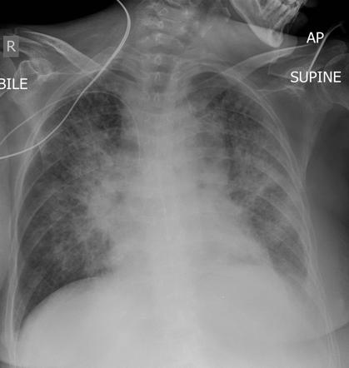
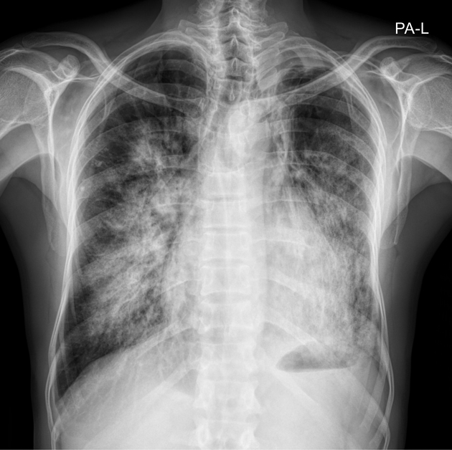
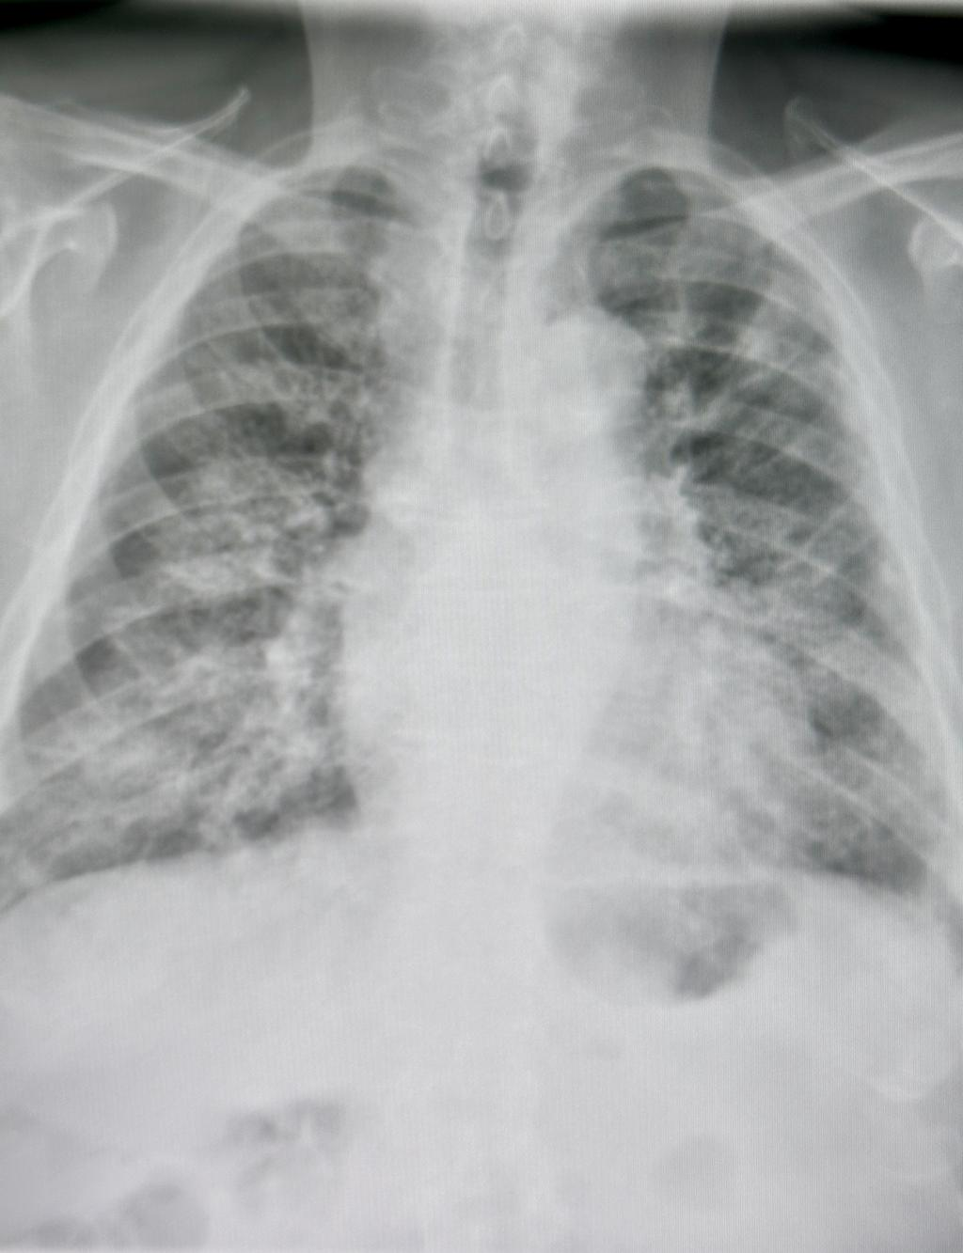
Investigations
CXR: pulmonary oedema
“Bat-wing” / Perihilar shadowing
Bilateral central opacities radiating from the hilum
Classic for alveolar pulmonary oedema
2. Cardiomegaly
Enlarged cardiac silhouette (CTR > 50%)
Suggests cardiogenic cause (heart failure)
Kerley B lines
Short horizontal lines at lung bases
Indicate interstitial oedema
Alveolar shadowing
Patchy or diffuse white opacities
Represents fluid-filled alveoli
Pleural effusions
Blunting of costophrenic angles
Often bilateral
Pathophysiology Link (teach this clearly)
↑ Left ventricular pressure
→ ↑ pulmonary venous pressure
→ Fluid leaks into:
  Interstitium (early → Kerley B lines)
  Alveoli (late → consolidation)
BNP elevated
Echo: EF assessment

Slide 8
↓ Cardiac Output (Heart Failure)
↓
↓ Perfusion to organs (Brain, Kidneys)
↓
-----------------------------------------
| |
▼ ▼
SNS Activation RAAS Activation
(Sympathetic Nervous System) (Kidneys)
↑ Heart Rate Renin release
↑ Contractility ↓
Vasoconstriction Angiotensin II
↓
Vasoconstriction
↑ Afterload
↓
Aldosterone
↓
Na⁺ + Water Retention
-----------------------------------------
↓
↑ Blood Volume + Vasoconstriction
↓
↑ Cardiac Workload (Strain on Heart)
↓
↑ Pulmonary Circulatory Pressure
↓
Fluid shifts into lung interstitium
↓
Alveolar fluid accumulation
↓
🫁 Pulmonary Oedema
↓
❌ Impaired Gas Exchange (V/Q mismatch)
↓
👉 Dyspnoea

Slide 9
Medical Management
Diuretics
ACEi/ARB, Beta-blockers
SGLT2 inhibitors
Oxygen if hypoxic

Slide 10
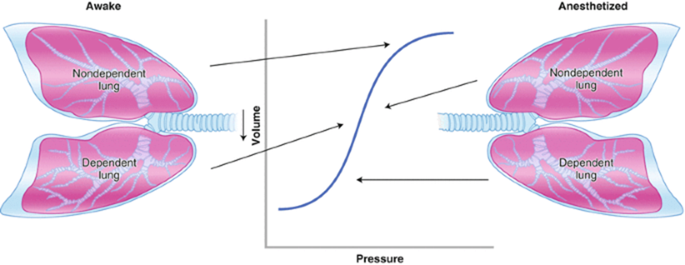
Physiotherapy Role
Positioning (upright)
Breathing control
Exercise training
Education

